Slide 1


Department Of Collegiate And Technical Education Diploma In E&CE
Government of Karnataka
Electronics & communications Engineering
Automation & Robotics (V Semester)
Week-8 : Session : 2

Slide 2
CONTENTS
Introuction to Robotics
Explain the need for Robotics in automation industries
Types of robots
Work Volume
Degree of freedom

Slide 3
INTRODUCTION TO ROBOTICS
A Robot is a reprogrammable manipulator designed to move materials , parts , tools or special devices through variable programmed motions for the performance of variety of tasks.
BASIC PARTS OF ROBOT SYSTEM
Robot structure is concerned with the physical construction & characteristics , Body , Arm, Wrist which are parts of the Robot .

Slide 4
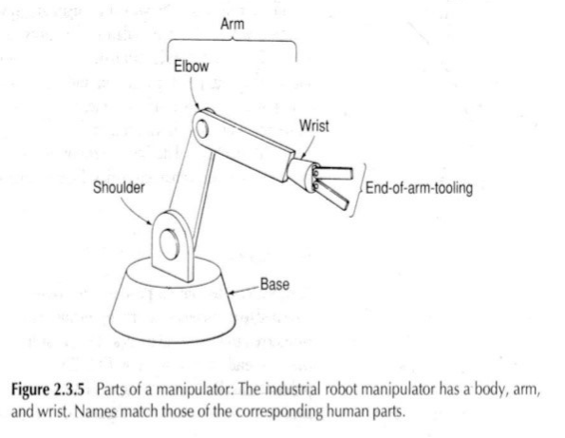
Most robot to-day are mounted on a base . The body is attached to the base and the arm assembled to the body . At the end of the arm is wrist which holds the gripper or end effector that performs the work.
Arm and Body moment include 3 motions like
Verticle motion- this motion includes up and down movements of the arm.
Radial motion-Radial motion includes in & out moments ie front and back.
Rotational motion – This includes rotation of the arm .

Slide 5
WRIST MOTION: -
Wrist rotation movement –It is the rotation of the wrist perpendicular to the end of the arm.
Wrist bend: - It is the movement of the wrist in up and down direction .
NEED FOR ROBOTICS IN AUTOMATION INDUSTRIES
To cope with increasing demands of a dynamic and competitive market, modern manufacturing methods should satisfy the following requirements:
Reduced production cost
Increased productivity
Improved product quality

Slide 6
NEED FOR ROBOTICS IN AUTOMATION INDUSTRIES
Notes: (1) Automation can help to fulfil the above requirements
(2) Automation: Either Hard or flexible automation
(3) Robotics is an example of flexible automation
INDUSTRIAL APPLICATIONS OF ROBOTS
Most industrial applications of robots can be divided into the following three categories:
1.Material handling and machine loading and unloading applications.
In these applications the robot's function is to move materials or parts
from One location in the work cell to some other location .

Slide 7
2.Processsing applications.
This category includes spot welding
Arc welding
Spray painting
Other operations in which the function of the robot is to manipulate a tool to accomplish some manufacturing process in the work cell. Spot welding represents a particularly important application in the processing category.
3.Assembly and inspection.
These are two separate operations, which we include together in this category. Robotic assembly is a field in which industry is showing great interest because of the economic potential.

Slide 8
NON-INDUSTRIAL APPLICATIONS OF ROBOTS
Among non-industrial uses some of the important potential applications are as follows:
1.Ocean exploration
2.Agriculture and forestry
3.Construction industry
4.Mining and coal mining
5.Defence
6.Entertainment

Slide 9
7.Household jobs
8.Sports training
9.Nuclear applications
10.Medical applications
11.Space applications
12.Wool shearing

Slide 10
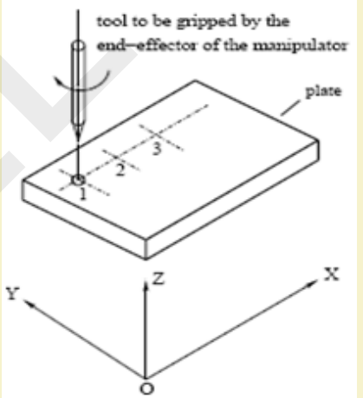
CLASSIFICATION OF ROBOTS
BASED ON THE TYPE OF TASKS PERFORMED
Point-to-Point Robots
Example: Unimate 2000, T3, NPT
Continuous Path Robots
Examples: PUMA, CRS .

Slide 11
BASED ON THE TYPE OF CONTROLLERS
1. Non-Servo-Controlled Robots
Open-loop control system
Examples: Seiko PN-100
Less accurate and less expensive
2. Servo-Controlled Robots
Closed-loop control system
Examples: Unimate 2000, PUMA, T3
More accurate and more expensive

Slide 12
BASED ON CONFIGURATION
(Coordinate system) of the Robot
Cartesian Coordinate Robots
Linear movement along three
different axes
Have either sliding or prismatic
joints, that is, SSS or PPP
Rigid and accurate ▪ Suitable for pick and place type
of operations
Examples: IBM’s RS -1, Sigma robot

Slide 13
2 Cylindrical Coordinate Robots
Two linear and one rotary
movements
Represented as TPP, TSS
Used to handle parts/ objects in manufacturing.
Cannot reach the objects lying on the floor
Poor dynamic performance
Examples: Versatran 600

Slide 14
3 Spherical Coordinate or Polar Coordinate Robots
One linear and two rotary movement
Represented as TRP, TRS
Suitable for handling parts/objects in manufacturing
Can pick up objects lying on the floor
Poor dynamic performance ▪ Examples: Unimate 2000B
4 Revolute Coordinate or Articulated Coordinate Robots
Rotary movement about three independent axes
Represented as TRR
Suitable for handling parts/components in manufacturing system
Rigidity and accuracy may not be good enough
Examples: T3, PUMA

Slide 15
BASED ON MOBILITY LEVELS
Robots with fixed base (also known as manipulators)
Serial Ex: PUMA, CRS
Parallel Ex: Stewart platform
2 Mobile robots
Wheeled Robots
Tracked robots
Multi-legged robots

Slide 16
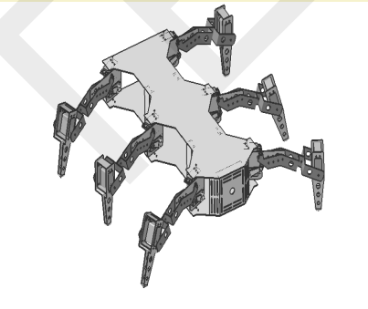
Fig: Six-legged Robot

Slide 17
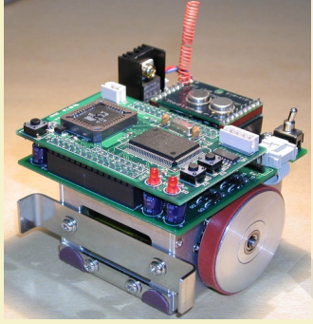
Fig: Wheeled Robot

Slide 18

WORK VOLUME:
It refers to the space with in the robot can operate, that is robot can reach. It is determined by its physical configuration, size and the limits of its arm and joint manipulations. For instance, the work volume of a polar-co-ordinate system will be a partial sphere, that of a joined arm robot will be somewhat irregular and so on..

Slide 19
DEXTROUS WORKSPACE
It is the volume of space, which the robot’s end-effector can reach with various orientations
Reachable Workspace
It is the volume of space that the end-effector can reach with one orientation
Note: Dextrous workspace is a subset of the reachable workspace

Slide 20
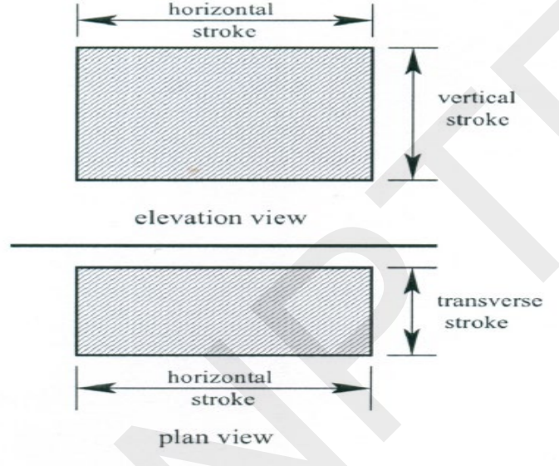
WORKSPACE OF CARTESIAN COORDINATE ROBOT

Slide 21
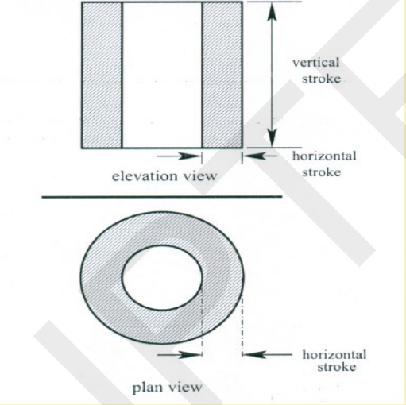
WORKSPACE OF CYLINDRICAL COORDINATE ROBOT

Slide 22
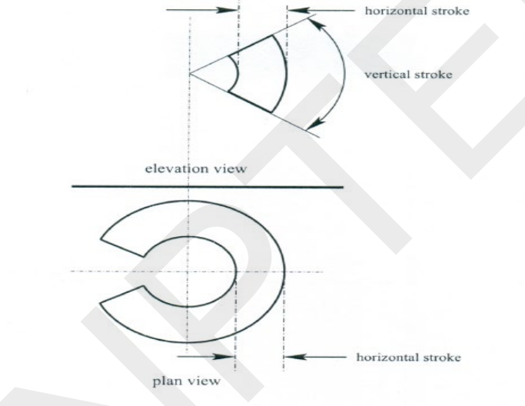
WORKSPACE OF SPHERICAL COORDINATE ROBOT

Slide 23
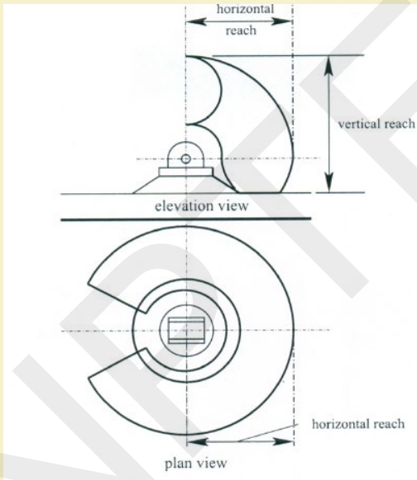
WORKSPACE OF REVOLUTE COORDINATE ROBOT

Slide 24
DEGREES OF FREEDOM
A typical robot arm will have 6 DOF. Only 3 DOF are necessary to get it anywhere in space, but 6 gives it more versatility.
To put it in simpler terms, each of the following is one degree of freedom:
1.Moving up and down(heaving);
2.moving left and right(swaying);
3.moving forward and back(surging);
4.tilting up and down(pitching);
5.turning left and right(yawing);
6.tilting side to side(rolling).

Slide 25
